Slide 1
Applied Mechanism Design For Social Good
John P Dickerson
Lecture #15 – 03/31/2020
CMSC828M
Tuesdays & Thursdays
2:00pm – 3:15pm

Slide 2
This class: Matching & Maybe the NRMP

Slide 3
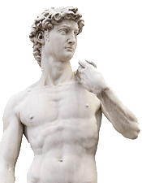
Overview of this lecture
Stable marriage problem
Bipartite, one vertex to one vertex
Stable roommates problem
Not bipartite, one vertex to one vertex
Hospitals/Residents problem
Bipartite, one vertex to many vertices

Slide 4
Matching without incentives
Given a graph G = (V, E), a matching is any set of pairwise non-adjacent edges
No two edges share the same vertex
Classical combinatorial optimization problem
Bipartite matching:
Bipartite graph G = (U, V, E)
Max cardinality/weight matching found easily – O(VE) and better
E.g., through network flow, Hungarian algorithm, etc
Matching in general graphs:
Also PTIME via Edmond’s algorithm – O(V²E) and better

Slide 5
Stable marriage problem
Complete bipartite graph with equal sides:
n men and n women (old school terminology ☹)
Each man has a strict, complete preference ordering over women, and vice versa
Want: a stable matching
Stable matching: No unmatched man and woman both prefer each other to their current spouses

Slide 6
Example preference profiles
>
>
Albert | Diane | Emily | Fergie
Bradley | Emily | Diane | Fergie
Charles | Diane | Emily | Fergie
Diane | Bradley | Albert | Charles
Emily | Albert | Bradley | Charles
Fergie | Albert | Bradley | Charles

Slide 7
Example matching #1
Albert | Diane | Emily | Fergie
Bradley | Emily | Diane | Fergie
Charles | Diane | Emily | Fergie
Diane | Bradley | Albert | Charles
Emily | Albert | Bradley | Charles
Fergie | Albert | Bradley | Charles
Is this a stable matching?

Slide 8
Example matching #1
Albert | Diane | Emily | Fergie
Bradley | Emily | Diane | Fergie
Charles | Diane | Emily | Fergie
Diane | Bradley | Albert | Charles
Emily | Albert | Bradley | Charles
Fergie | Albert | Bradley | Charles
No.
Albert and Emily form a blocking pair.

Slide 9
Example matching #2
Albert | Diane | Emily | Fergie
Bradley | Emily | Diane | Fergie
Charles | Diane | Emily | Fergie
Diane | Bradley | Albert | Charles
Emily | Albert | Bradley | Charles
Fergie | Albert | Bradley | Charles
What about this matching?

Slide 10
Example matching #2
Albert | Diane | Emily | Fergie
Bradley | Emily | Diane | Fergie
Charles | Diane | Emily | Fergie
Diane | Bradley | Albert | Charles
Emily | Albert | Bradley | Charles
Fergie | Albert | Bradley | Charles
Yes!
(Fergie and Charles are unhappy, but helpless.)

Slide 11
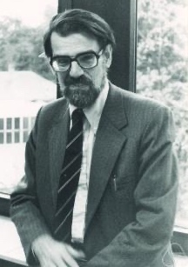
Some questions
Does a stable solution to the marriage problem always exist?
Can we compute such a solution efficiently?
Can we compute the best stable solution efficiently?
Hmm …
Hmm …
Lloyd Shapley
David Gale

Slide 12
Gale-Shapley [1962]
Everyone is unmatched
While some man m is unmatched:
w := m’s most-preferred woman to whom he has not proposed yet
If w is also unmatched:
w and m are engaged
Else if w prefers m to her current match m’
w and m are engaged, m’ is unmatched
Else: w rejects m
Return matched pairs

Slide 13
Claim
GS terminates in polynomial time (at most n² iterations of the outer loop)
Proof:
Each iteration, one man proposes to someone to whom he has never proposed before
n men, n women → n×n possible events
(Can tighten a bit to n(n - 1) + 1 iterations.)

Slide 14
Claim
GS results in a perfect matching
Proof by contradiction:
Suppose BWOC that m is unmatched at termination
n men, n women → w is unmatched, too
Once a woman is matched, she is never unmatched; she only swaps partners. Thus, nobody proposed to w
m proposed to everyone (by def. of GS): ><

Slide 15
Claim
GS results in a stable matching (i.e., there are no blocking pairs)
Proof by contradiction (1):
Assume m and w form a blocking pair
Case #1: m never proposed to w
GS: men propose in order of preferences
m prefers current partner w’ > w
→ m and w are not blocking

Slide 16
Claim
GS results in a stable matching (i.e., there are no blocking pairs)
Proof by contradiction (2):
Case #2: m proposed to w
w rejected m at some point
GS: women only reject for better partners
w prefers current partner m’ > m
→ m and w are not blocking
Case #1 and #2 exhaust space. ><

Slide 17
Recap: Some questions
Does a stable solution to the marriage problem always exist?
Can we compute such a solution efficiently?
Can we compute the best stable solution efficiently?
We’ll look at a specific notion of “the best” – optimality with respect to one side of the market

Slide 18
(Wo)Man optimality/pessimality
Let S be the set of stable matchings
m is a valid partner of w if there exists some stable matching S in S where they are paired
A matching is man optimal (resp. woman optimal) if each man (resp. woman) receives their best valid partner
Is this a perfect matching? Stable?
A matching is man pessimal (resp. woman pessimal) if each man (resp. woman) receives their worst valid partner

Slide 19
Claim
GS – with the man proposing – results in a man-optimal matching
Proof by contradiction (1):
Men propose in order → at least one man was rejected by a valid partner
Let m and w be the first such reject in S
This happens because w chose some m’ > m
Let S’ be a stable matching with m, w paired
(S’ exists by def. of valid)

Slide 20
Claim
GS – with the man proposing – results in a man-optimal matching
Proof by contradiction (2):
Let w’ be partner of m’ in S’
m’ was not rejected by valid woman in S before m was rejected by w (by assump.)
→ m’ prefers w to w’
Know w prefers m’ over m, her partner in S’
→ m’ and w form a blocking pair in S’ ><

Slide 21
Recap: Some questions
Does a stable solution to the marriage problem always exist?
Can we compute such a solution efficiently?
Can we compute the best stable solution efficiently?
*
For one side of the market. What about the other side?

Slide 22
Claim
GS – with the man proposing – results in a woman-pessimal matching
Proof by contradiction:
m and w matched in S, m is not worst valid
→ exists stable S’ with w paired to m’ < m
Let w’ be partner of m in S’
m prefers to w to w’ (by man-optimality)
→ m and w form blocking pair in S’ ><

Slide 23
Incentive issues
Can either side benefit by misreporting?
(Slight extension for rest of talk: participants can mark possible matches as unacceptable – a form of preference list truncation)
Any algorithm that yields woman- (man-)optimal matching → truthful revelation by women (men) is dominant strategy [Roth 1982]

Slide 24
In GS with men proposing, women can benefit by misreporting preferences
Truthful reporting
Albert | Diane | Emily
Bradley | Emily | Diane
Diane | Bradley | Albert
Emily | Albert | Bradley
Albert | Diane | Emily
Bradley | Emily | Diane
Diane | Bradley | Albert
Emily | Albert | Bradley
Strategic reporting
Albert | Diane | Emily
Bradley | Emily | Diane
Diane | Bradley | 
Emily | Albert | Bradley
Albert | Diane | Emily
Bradley | Emily | Diane
Diane | Bradley | 
Emily | Albert | Bradley

Slide 25
Claim
There is no matching mechanism that:
is strategy proof (for both sides); and
always results in a stable outcome (given revealed preferences)

Slide 26
Extensions to stable marriage

Slide 27
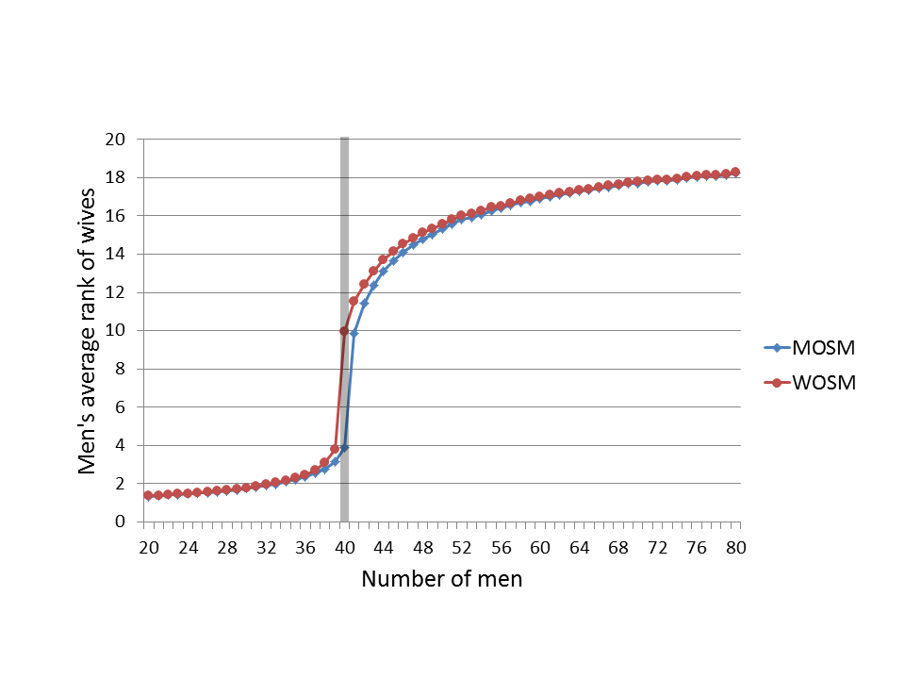
Imbalance [Ashlagi et al. 2013]
What if we have n men and n’ ≠ n women?
How does this affect participants? Core size?
Being on short side of market: good!
W.h.p., short side get rank ~log(n)
… long side gets rank ~random
# women held constant at n’ = 40

Slide 28
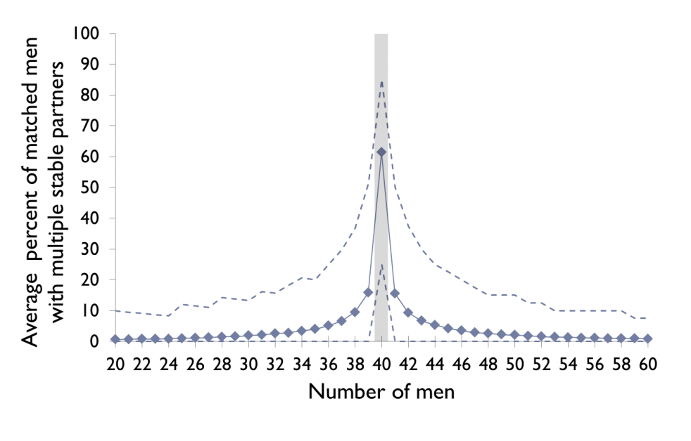
Imbalance [Ashlagi et al. 2013]
Not many stable matchings with even small imbalances in the market

Slide 29
Imbalance [Ashlagi et al. 2013]
“Rural hospital theorem” [Roth 1986]:
The set of residents and hospitals that are unmatched is the same for all stable matchings
Assume n men, n+1 women
One woman w unmatched in all stable matchings
→ Drop w, same stable matchings
Take stable matchings with n women
Stay stable if we add in w if no men prefer w to their current match
→ average rank of men’s matches is low

Slide 30
Online arrival [Khuller et al. 1993]
Random preferences, men arrive over time, once matched nobody can switch
Algorithm: match m to highest-ranked free w
On average, O(nlog(n)) unstable pairs
No deterministic or randomized algorithm can do better than Ω(n²) unstable pairs!
Not better with randomization ☹

Slide 31
Incomplete prefs [Manlove et al. 2002]
Before: complete + strict preferences
Easy to compute, lots of nice properties
Incomplete preferences
May exist: stable matchings of different sizes
Everything becomes hard!
Finding max or min cardinality stable matching
Determining if <m,w> are stable
Finding/approx. finding “egalitarian” matching

Slide 32
Non-bipartite graph …?
Matching is defined on general graphs:
“Set of edges, each vertex included at most once”
(Finally, no more “men” or “women” …)
The stable roommates problem is stable marriage generalized to any graph
Each vertex ranks all n-1 other vertices
(Variations with/without truncation)
Same notion of stability

Slide 33
Is this different than stable marriage?
>
>
Alana | Brian | Cynthia | Dracula
Brian | Cynthia | Alana | Dracula
Cynthia | Alana | Brian | Dracula
Dracula | (Anyone) | (Anyone) | (Anyone)
No stable matching exists!
Anyone paired with Dracula (i) prefers some other v and (ii) is preferred by that v

Slide 34
Hopeless?
Can we build an algorithm that:
Finds a stable matching; or
Reports nonexistence
… In polynomial time?
Yes! [Irving 1985]
Builds on Gale-Shapley ideas and work by McVitie and Wilson [1971]
Hmm …

Slide 35
Irving’s algorithm: Phase 1
Run a deferred acceptance-type algorithm
If at least one person is unmatched: nonexistence
Else: create a reduced set of preferences
a holds proposal from b → a truncates all x after b
Remove a from x’s preferences
Note: a is at the top of b’s list
If any truncated list is empty: nonexistence
Else: this is a “stable table” – continue to Phase 2

Slide 36
Stable tables
a is first on b’s list iff b is last on a’s
a is not on b’s list iff
b is not on a’s list
a prefers last element on list to b
No reduced list is empty
Note 1: stable table with all lists length 1 is a stable matching
Note 2: any stable subtable of a stable table can be obtained via rotation eliminations

Slide 37
Irving’s algorithm: Phase 2
Stable table has length 1 lists: return matching
Identify a rotation:
Eliminate it:
a₀ rejects b₀, proposes to b₁ (who accepts), etc.
If any list becomes empty: nonexistence
If the subtable hits length 1 lists: return matching
(a₀,b₀),(a₁,b₁),…,(a_{k-1},b_{k-1}) such that:
b_{i} is first on a_{i}’s reduced list
b_{i+1} is second on a_{i}’s reduced list (i+1 is mod k)

Slide 38
Claim
Irving’s algorithm for the stable roommates problem terminates in polynomial time – specifically O(n²).
This requires some data structure considerations
Naïve implementation of rotations is ~O(n³)

Slide 39
One-to-many matching
The hospitals/residents problem (aka college/students problem aka admissions problem):
Strict preference rankings from each side
One side (hospitals) can accept q > 1 residents
Also introduced in [Gale and Shapley 1962]
Has seen lots of traction in the real world
E.g., the National Resident Matching Program (NRMP)
Later will talk about school choice

Slide 40
Overview of an impactful paper in this space
[Roth & Peranson 1999]
Redesign of the Matching Market for American Physicians
Big thanks to Candice Schumann for slides!

Slide 41
The Matching Problem
Couples
Second-year positions need prerequisite first-year positions
Residency programs with positions that revert to other programs if they are unfilled
Programs that need an even number of positions filled
Notes:
These problems create complementaries between positions or applications

Slide 42
The Matching Problem
Simple Markets | Markets with Complementaries
Optimal stable matchings exist | No stable matching may exist AND there may by no optimal stable matchings
Same applicants matched, same positions filled | Different stable matchings may have different applicants and positions filled
When applicant proposing is used a dominant strategy for applicants to submit true preferences | No algorithm where a dominant strategy for all agents to state true preferences

Slide 43
History of the NRMP
1950’s Market Failure
1951 Clearinghouse Started
1990’s Crisis of Confidence
1995 Commissioned the design of a new algorithm
1997 Switched to new algorithm
1998 First match completed with new algorithm
Notes:
1950s market failure
Clearinghouse created in early 1950s
mid 1990s crisis of confidence
- American Medical Student Association, Ralph Nader’s Public Citizen Health Research Group, the Medical Student Section of the Amrican Medical Association
1995 Board of Directors commissioned the design of a new algorithm and a study comparing the old and new
1997 Switched to new algorithm
1998 First match successfully completed with new algorithm

Slide 44
The Preexisting Algorithm
Phase 1
Program proposing
Ignores most variations
Couples hold onto offers
Phase 2
Identifies instabilities
Phase 3
Fixes instabilities one by one
Sometimes couples propose to programs
When no match variations are present this produces program-optimal stable matching (Thoracic Surgery)

Slide 45
Is There a Problem?
Are there a lot of variations?
4% couples
8-12% submit supplemental rank order lists (ROLs)
7% of programs have positions that revert to other positions if unfilled
Thoracic Surgery match is a simple match
Two (of many) questions to ask:
Does a program optimal solution make the physicians happy?
Can applicants act strategically?

Slide 46
Applicant Proposing Algorithm
Assemble a set A(k) of residency programs and applicants.
Tentative matching M(k) with no instabilities.
No applicant or program in A(k) is matched to anyone outside of A(k).
When A(k) has grown to include all applicants and programs, then the matching M(k) is a stable matching
Notes:
No instabilities:
- no applicant or program in A(k) is matched to anyone outside of A(k).

Slide 47
Applicant Proposing Algorithm
A(0):
consists of all positions offered in the match
All positions are vacant
A(1):
Select an applicant S(1) and add S(1) to A(0) to make A(1).

Slide 48
Applicant Proposing Algorithm
For any step k of the algorithm:
Applicant S(k) proposes down his ROL to programs who also have S(k) in the rank.
Stop when there is a vacant position or the program prefers S(k) to its least preferred accepted applicant
The applicant S(k,2) is rejected and starts proposing to new programs down his ROL
Each S(k,n) is displaced and proposes down his/her ROL

Slide 49
Applicant Proposing Algorithm
What about couples or supplemental positions?
If a couple is displaced a position is left vacant. This is put on the “program stack”
Couple propose to programs together
They each may displace another applicant!
One displaced applicant is processed immediately. Others are added to the “applicant stack”
Proceed until the “applicant stack” is empty

Slide 50
Applicant Proposing Algorithm
Dealing with instabilities
For each position in the “program stack” all applicants in A(k) are found that cause instabilities
Add these applicants to the “applicant stack”
Empty the “applicant stack”
Once both the applicant stack and the program stack are empty you now have the tentative matching M(k).
When all applicants have been added to A(k), even/odd requests and program reversions are adjusted.
Handle inconsistencies the same way as before
Notes:
In a simple matching (no variations) the position and applicant stack will always remain empty. This is the same as in Thoracic Surgery

Slide 51
Loops in the Applicant Proposing Algorithm
…

Slide 52
Sequence Changes
Ran computational experiments
Differences in matches was extremely small and did not appear to be systematic
Did effect number of loops
Fewest when couples where introduced last
Notes:
Does not change the prospects of couples

Slide 53
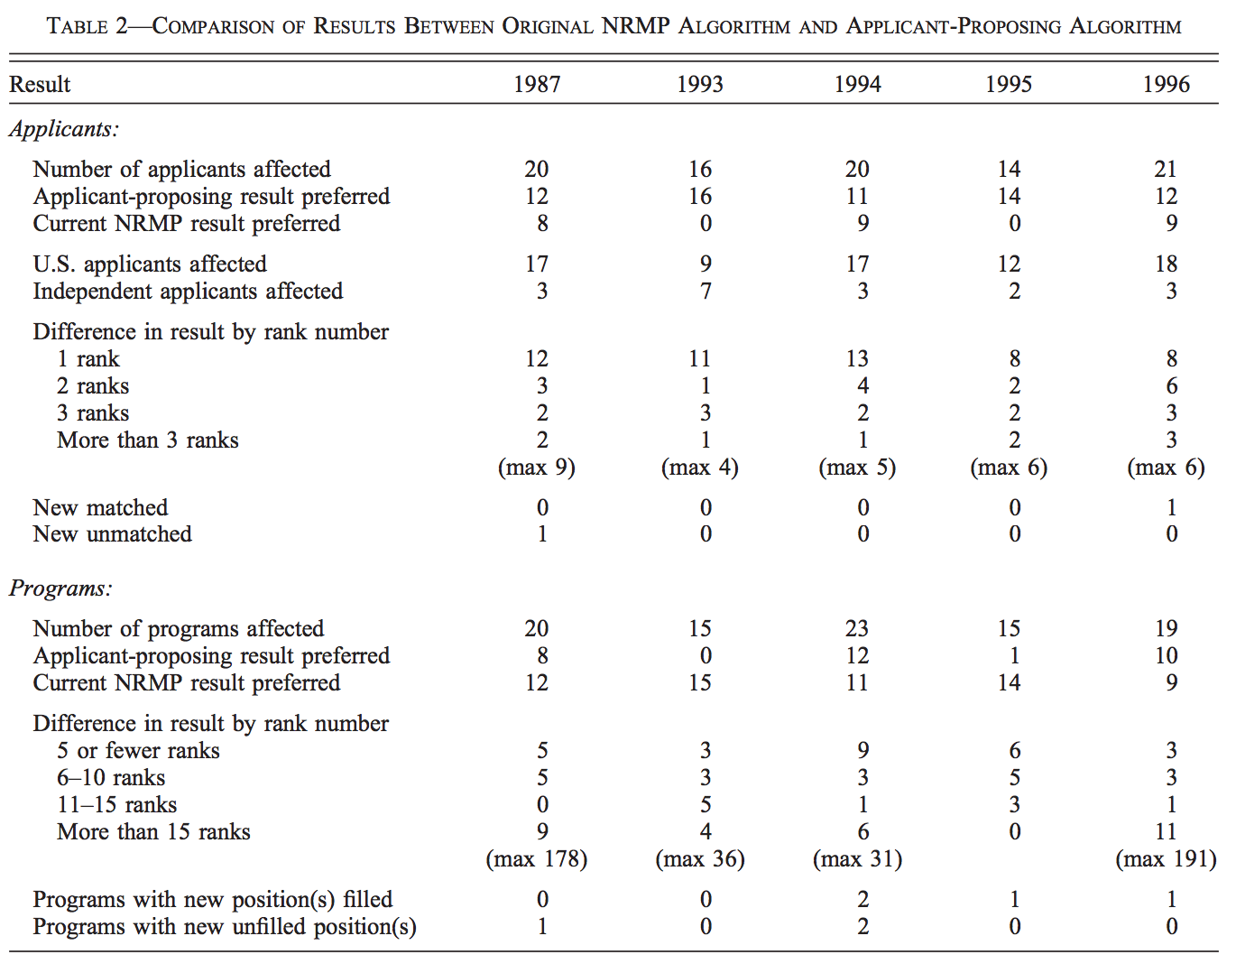
Results of the New Algorithm

Slide 54
Is the Change Worth It?
0.1% of applicants affected
Most of those affected prefer the new algorithm
0.5% of programs affected
Most of those affected prefer the old algorithm
This does not imply the associated change in welfare is small
Large increase for affected applicants
Small decrease for the affected programs

Slide 55
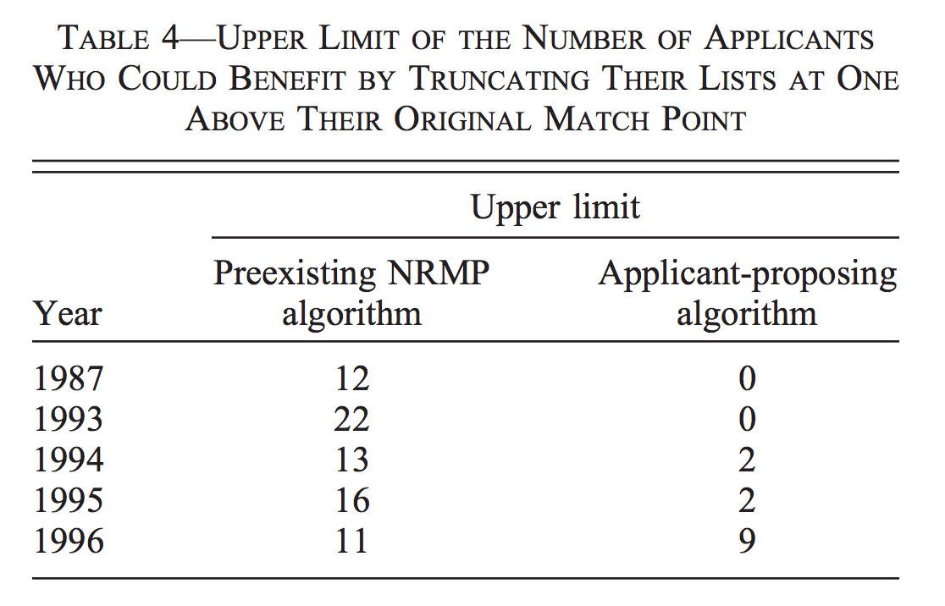
Strategic Behavior of Participants
Notes:
Assumes fill knowledge
- if they truncate one more than they should they could be not matched at all
- Extremely risky
Those that benefitted from ROL truncations were, for the most part, those who did differently when the algorithm was changed from their side proposing to the other side proposing.

Slide 56
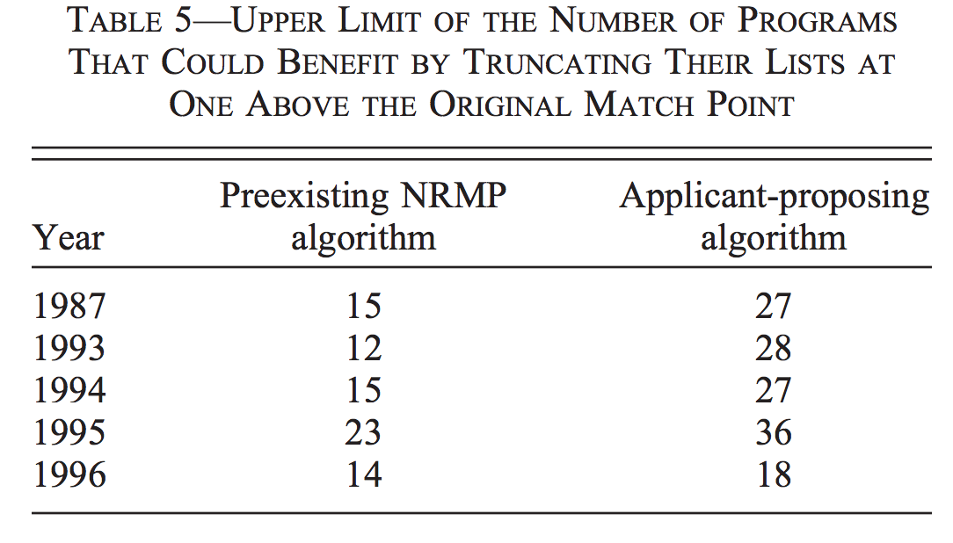
Strategic Behavior of Programs

