Slide 1
Applied Mechanism Design For Social Good
John P Dickerson
Lecture #17 – 04/07/2020
CMSC828M
Tuesdays & Thursdays
2:00pm – 3:15pm

Slide 2
This class: Organ Exchange

Slide 3
Kidney transplantation
US waitlist: over 100,000
Over 35,000 added per year
~4500 people died while waiting
~12000 people received a kidney from the deceased donor waitlist
(See last class’ lecture on deceased donor allocation.)
~6000 people received a kidney from a living donor
Some through kidney exchanges!
Demand
Supply
Last time, I promise!
[Roth et al. 2004]

Slide 4
Kidney exchange
Wife
Husband
D₁ P₁
Donors
Patients
D₂ P₂
Brother
Brother
(2- and 3-cycles, all surgeries performed simultaneously)

Slide 5
Non-directed donors & chains
[Rees et al. 2009]
NDD
D1
D2
D3
…
Pay it forward
P1
P2
P3
Not executed simultaneously, so no length cap required based on logistic concerns …
… but in practice edges fail, so often some finite cap is used!

Slide 6
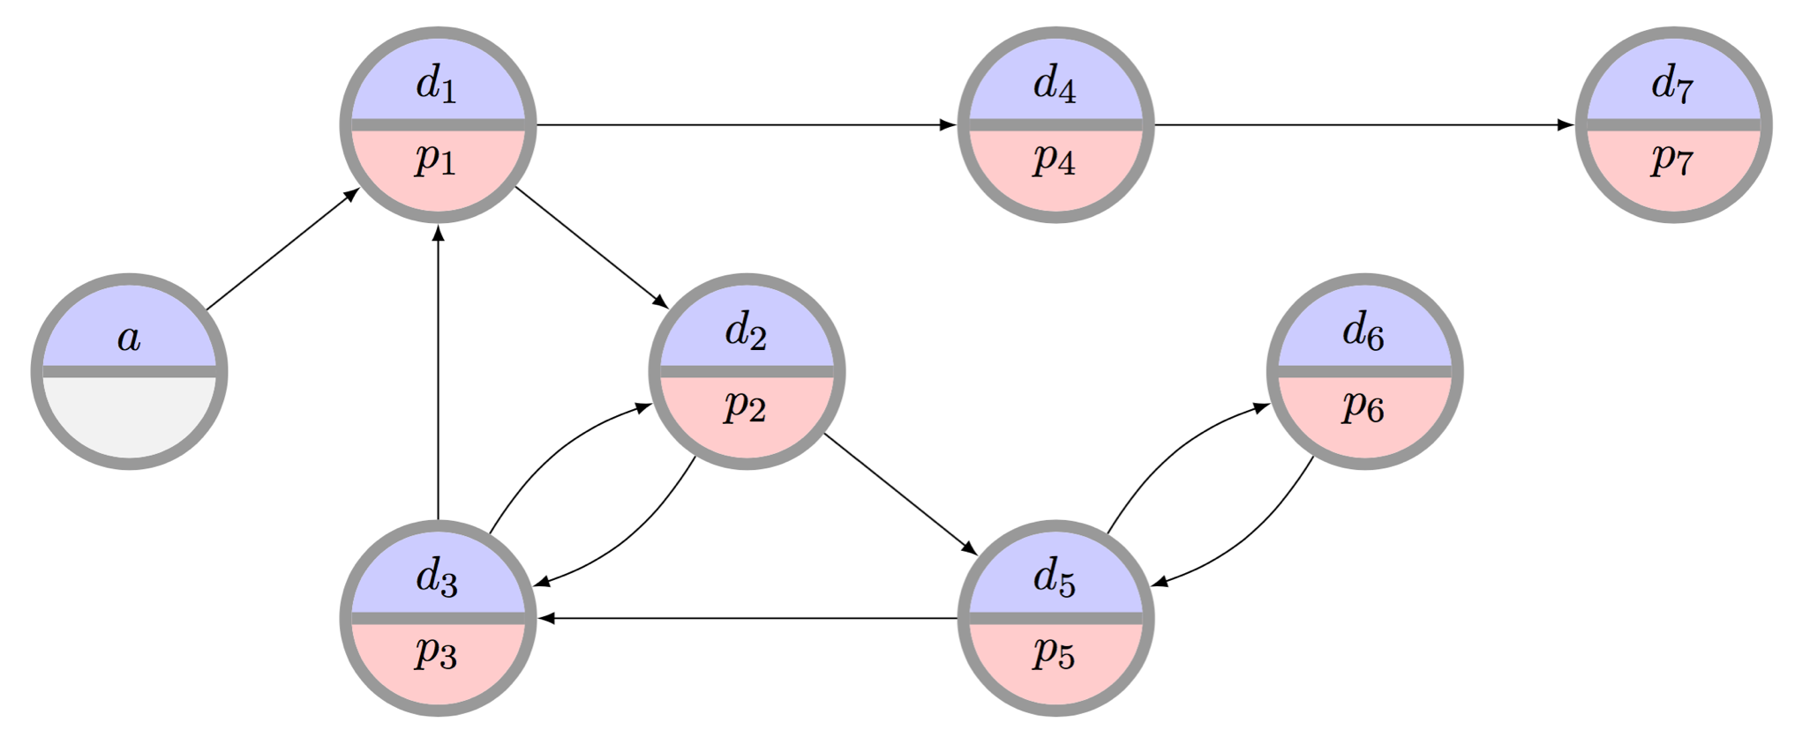
The clearing problem
The clearing problem is to find the “best” disjoint set of cycles of length at most L, and chains (maybe with a cap K)
Very hard combinatorial optimization problem that we will focus on in the succeeding two lectures.

Slide 7
Managing Incentives
Clearinghouse cares about global welfare:
How many patients received kidneys (over time)?
Transplant centers care about their individual welfare:
How many of my own patients received kidneys?
Patient-donor pairs care about their individual welfare:
Did I receive a kidney?
(Most work considers just clearinghouse and centers)

Slide 8
Individual rationality (IR)
Will I be better off participating in the mechanism than I would be otherwise?
Long-term IR:
In the long run, a center will receive at least the same number of matches by participating
Short-term IR:
At each time period, a center receives at least the same number of matches by participating

Slide 9
Strategy proofness
Do I have any reason to lie to the mechanism?
In any state of the world …
{ time period, past performance, competitors’ strategies, current private type, etc }
… a center is not worse off reporting its full private set of pairs and altruists than reporting any other subset
→ No reason to strategize

Slide 10
Efficiency
Does the mechanism result in the absolute best possible solution?
Efficiency:
Produces a maximum (i.e., max global social welfare) matching given all pairs, regardless of revelation
IR-Efficiency:
Produces a maximum matching constrained by short-term individual rationality

Slide 11
Private vs Global Matching

Slide 12
0%

Slide 13
First: Only Cycles (no Chains)

Slide 14
The basic kidney exchange game
[Ashlagi & Roth 2014, and earlier]
Set of n transplant centers T_{n} = {t₁ ... t_{n}}, each with a set of incompatible pairs V_{h}
Union of these individual sets is V, which induces the underlying compatibility graph
Want: all centers to participate, submit full set of pairs
An allocation M is k-maximal if there is no allocation M' that matches all the vertices in M and also more
Note: k-efficient → k-maximal, but not vice versa

Slide 15
Individually rational?
[Ashlagi & Roth 2014, and earlier]
Vertices a₁, a₂ belong to center a, b₁, b₂ belong to center b
Center a could match 2 internally
By participating, matches only 1 of its own
Entire exchange matches 3 (otherwise only 2)
????????????????
Center a
a₁
a₂
Center b
b₁
b₂

Slide 16
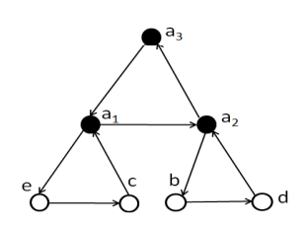
It can get much worse
[Ashlagi & Roth 2014, and earlier]
Theorem: For k>2, there exists G s.t. no IR k-maximal mechanism matches more than 1/(k-1)-fraction of those matched by k-efficient allocation
Bound is tight
All but one of a's vertices is part of another length k exchange (from different agents)
k-maximal and IR if a matches his k vertices (but then nobody else matches, so k total)
k-efficient to match (k-1)*k
Example: k=3

Slide 17
Restriction #1
[Ashlagi & Roth 2014, and earlier]
Theorem: For all k and all compatibility graphs, there exists an IR k-maximal allocation
Proof sketch: construct k-efficient allocation for each specific hospital's pool V_{h}
Repeatedly search for larger cardinality matching in an entire pool that keeps all already-matched vertices matched (using augmenting matching algorithm from Edmonds)
Once exhausted, done

Slide 18
Restriction #2
[Ashlagi & Roth 2014, and earlier]
Theorem: For k=2, there exists an IR 2-efficient allocation in every compatibility graph
Idea: Every 2-maximal allocation is also 2-efficient
This is a PTIME problem with, e.g., a standard O(|V|³) bipartite augmenting paths matching algorithm
By Restriction #1, 2-maximal IR always exists → this 2-efficient IR always exists

Slide 19
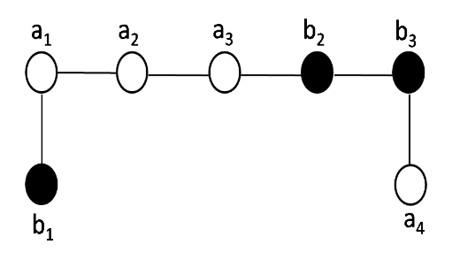
Restriction #3
[Ashlagi et al. 2015]
Theorem: No IR mechanism is both maximal and strategyproof (even for k=2)
Suppose mechanism is IR and maximal . . .

Slide 20
More negative mechanism design results
[Ashlagi et al. 2015]
Just showed IR + strategyproof → not maximal
No IR + strategyproof mechanism can guarantee more than ½-fraction of efficient allocation
Idea: same counterexample, note either the # matched for hospital a < 3, or # matched for hospital b < 2. Proof by cases follows
No IR + strategyproof randomized mechanism can guarantee 7/8-fraction of efficiency
Idea: same counterexample, bounds on the expected size of matchings for hospitals a, b

Slide 21
Hopeless …?

Slide 22
Dynamic, Credit-Based Mechanism
[Hajaj et al. AAAI-2015]
Repeated game
Centers are risk neutral, self interested
Transplant centers have (private) sets of pairs:
Maximum capacity of 2k_{i}
General arrival distribution, mean rate is k_{i}
Exist for one time period
Centers reveal subset of their pairs at each time period, can match others internally

Slide 23
Credits
Clearinghouse maintains a credit balance c_{i} for each transplant center over time
High level idea:
REDUCE c_{i}: center i reveals fewer than expected
INCREASE c_{i}: center i reveals more than expected
REDUCE c_{i}: mechanism tiebreaks in center i’s favor
INCREASE c_{i}: mechanism tiebreaks against center I Also remove centers who misbehave “too much.”
Credits now → matches in the future

Slide 24
The dynamic mechanism
Initial credit update
Centers reveal pairs
Mechanism updates credits according to k_{i}
Compute maximum global matching
Gives the utility U_{g} of a max matching
Selection of a final matching
Constrained to those matchings of utility U_{g}
Take c_{i} into account to (dis)favor utility given by matching to a specific center i
Update c_{i} based on this round’s (dis)favoring
Removal phase if center is negative for “too long”

Slide 25
Theoretical guarantees
Theorem: No mechanism that supports cycles and chains can be both long-term IR and efficient
Theorem: Under reasonable assumptions, the prior mechanism is both long-term IR and efficient

Slide 26
Lots of open problems here
Dynamic mechanisms are more realistic, but …
Vertices disappear after one time period
All hospitals the same size
No weights on edges
No uncertainty on edges or vertices
Upper bound on number of vertices per hospital
Distribution might change over time
...
Project?

Slide 27
What do efficient matchings Even look like …?
Next class: given a specific graph, what is the “optimal matching”
This class: given a family of graphs, what do ”optimal matchings” tend to look like?
Use a stylized random graph model, like [Saidman et al. 2006]:
Patient and donor are drawn with blood types randomly selected from PDF of blood types (roughly mimics US makeup), randomized “high” or “low” CPRA
Edge exists between pairs if candidate and donor are ABO-compatible and tissue type compatible (random roll weighted by CPRA)

Slide 28
Random graph Primer
Canonical Erdős-Rényi random graph G(m,p) has m vertices and an (undirected) edge between two vertices with probability p
Let Q be the property of “there exists a perfect matching” in this graph
The convergence rate to 1 (i.e., “there is almost certainly a near perfect matching in this graph) is exponential in p
Pr(G(m,m,p) satisfies Q) = 1 – o(2^{-mp})
At least as strong with non-bipartite random graphs
Early random graph results in kidney exchange are for “in the large” random graphs that (allegedly) mimic the real compatibility graphs
All models are wrong, but some are useful?

Slide 29
A stylized Erdős-Rényi-style Model of Kidney Exchange
In these random (ABO- & PRA-) graphs:
# of O-{A, B, AB} pairs > {A, B, AB}-O pairs
# of {A, B}-AB pairs > AB-{A, B} pairs
Constant difference between # A-B and # B-A
Idea #1: O-candidates are hard to self-match
Idea #2: {A, B}-candidates are hard to self-match
Idea #3: “symmetry” between A-B and B-A (equally hard to self-match, give or take)

Slide 30
Efficient matching in dense graphs with only cycles
Under some other assumptions about PRA …
Almost every large random (ABO- & PRA-) graph has an efficient allocation that requires exchanges of size at most 3 with the following:
X-X pairs are matched in 2- or 3-way exchanges with other X-X pairs (so-called “self-demand”)
B-A pairs are 2-matched with A-B pairs
The leftovers of {A-B or B-A} are 3-matched with “good” {O-A, O-B} pairs and {O-B, O-A pairs}
3-matches with {AB-O, O-A, A-AB}
All the remaining 2-matched as {O-X, X-O}

Slide 31
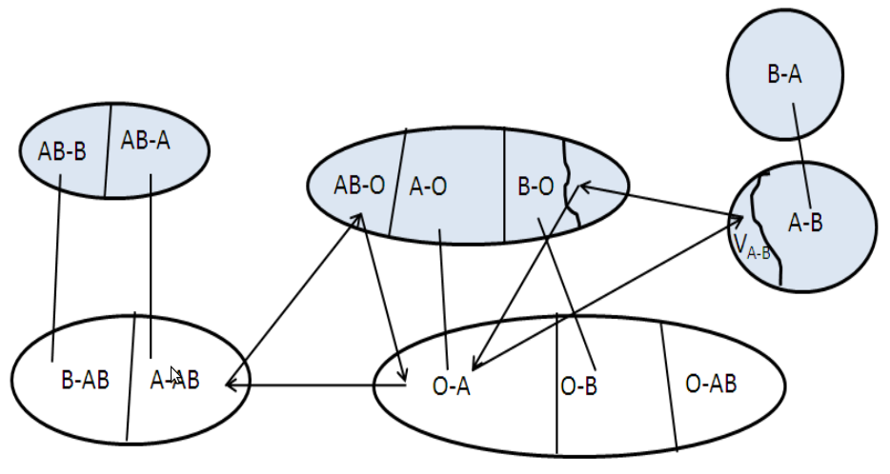
Visually …

Slide 32
Next Class: Optimal batch clearing of Organ exchanges

